Slide 1
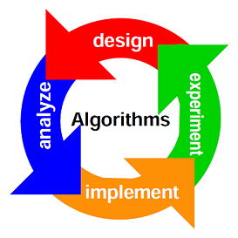
DESIGN AND ANALYSIS OF ALGORITHMS
Introductory Session

Slide 2
Module I
Introduction: Algorithm, Concepts in performance analysis – space complexity and time complexity, Asymptotic Notations
Sorting: Analysis of - Bubble sort, Selection sort and Insertion sort
Searching: Analysis of - Linear Search, Binary Search and Interpolation Search.
Hashing Techniques: Different hashing functions, methods for collision handling.

Slide 3
Algorithm
A step by step procedure for solving Computational Problems.

Slide 4
Example
Sorting Problem
Input: A sequence of n numbers(a1,a2,...an)
Output: A permutation (reordering)(a1,a2,...an) of the input sequence such that a1<=a2<=...an

Slide 5
Algorithm Vs Program
Algorithm
Program
Design
Requires Domain Knowledge
Any Language
Hardware and Operating System Independent
Analysis
Implementation
Programmer
Specific programming language
Hardware and Operating System Dependent
Testing

Slide 6
Priori Analysis
Posteriori Testing
Algorithm
Language Independent
Hardware Independent
Time and Space function
Program
Language Dependent
Hardware and OS dependent
Watch Time and Bytes

Slide 7
Characteristics Of Algorithm
Algorithm
Input (Range)
Output
Definiteness
Finiteness
Effectiveness
Efficiency(Speed)

Slide 8
Facts...
An algorithm is said to be correct if for every input instance, it halts with correct output
Algorithms should be designed such that it is efficient in terms of time and space
Computing time and space is a bounded resource

Slide 9
Issues In Algorithms
How to devise algorithms
How to validate algorithms
How to analyze algorithms

Slide 10
Analysis of Algorithm- Factors
Time Efficiency/Time Complexity
Space Efficiency/Space Complexity
Simplicity
Generality
Range of input(Measuring Input size)
Computing best case, worst case and
average case efficiencies
Computing Order of growth
Performance Analysis of an Algorithm
Performance Analysis Measures

Slide 11
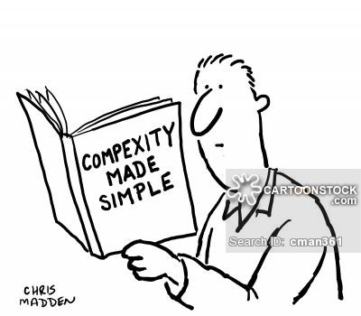
Space/Time Complexity
The space complexity of an algorithm is the amount of memory it needs to run to completion.
The time complexity of an algorithm is amount of computer time it needs to run to completion

Slide 12
Space Analysis Of An Algorithm
Space required to store the data values
The space needed is the sum of the component factors:
Fixed part : Space of inputs & outputs, Instruction
Variable part: Space dependent upon instance characteristics
The space requirement S(P) of any algorithm P can be written as S(P)=c + Sp where c is a constant

Slide 13
Time Analysis Of An Algorithm
The time complexity of an algorithm is amount of computer time it needs to run to completion -running time + compile time
Difficult to compute the running time complexity in terms of physically clocked time, why?
Time complexity is given in terms of frequency count of the basic operation
Frequency count denotes the no. of times of execution of statement(basic operation).

Slide 14
Time Analysis Of An Algorithm
The estimate of the time is calculated by isolating a particular operation called as a basic operation
Example:
sum=0
Repeat for I=1,2 ….n
sum=sum+V[I]
Exit
In the above example the operation to be isolated is addition , the other operation is assignment
The rest of the operations are called book keeping operations and generally not counted

Slide 15
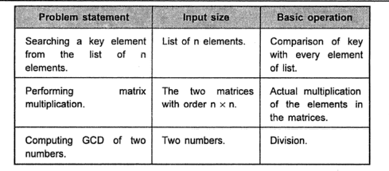
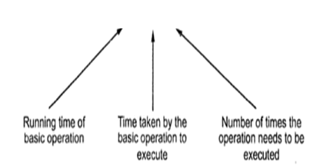
Basic Operation
Time consuming operation of an algorithm
Normally, located in inner loop
T(n) = t(B_{op})*No. of Basic Operations

Slide 16
Other Factors
Network Consumption
Power Consumption

Slide 17
Analyzing Algorithms

Slide 18
Analyzing the Algorithms-I
Frequency Count Method
Swapping two Elements
Algorithm Swap(a,b)
{
temp=a;
a=b;
b=temp;
}

Slide 19
Analyzing the Algorithms-II
Sum of elements of an array
Algorithm Sum(A,n)
{
s=0;
i=0;
While(i<n)
{
s=s+A[i];
i++;
}
return s;
}

Slide 20
Analyzing the Algorithms-II
Sum of elements of an array
Algorithm Sum(A,n)
{
s=0;
for(i=0;i<n;i++)
{
s=s+A[i];
}
return s;
}

Slide 21
Analyzing the Algorithms-III
Matrix Addition
Algorithm Add(A,B,n)
{
for(i=0;i<n;i++)
{ for(j=0;j<n;j++)
{
C[i,j]=A[i,j]+b[i,j];
}
}
}

Slide 22
Analyzing the Algorithms-IV
Matrix Multiplication
Algorithm Multiply(A,B,n)
{
for(i=0;i<n;i++)
{ for(j=0;j<n;j++)
{
C[i,j]=0;
for(j=0;j<n;j++)
{
C[i,j]=C[i,j]+A[i,k]*B[k,j];
}
}
}
}

Slide 23
Problems: Find the Time Complexity
Algorithm for finding the factorial
function(int n)
{
if (n==1)
return;
for (int i=1; i<=n; i++)
{
for (int j=1; j<=n; j++)
{
printf("*");
break;
}
}
}

Slide 24


